Slide 1

Weekly Report
Tianyu Wang
August 4,2021

Slide 2
Review of Last Meeting
Completed:
1.Collection of commit message
2.Collection of code comment(partial)
3.Collection of pull request message(partial)
To do:
Collect the code comment several lines before the starting line.
Complete the collection of pull request
Data cleaning

Slide 3
Work done this week

Slide 4

Data of Commit Message
project_name | title | body | total
Anki-Android | 881 | 185 | 1066
bnd | 1 | 0 | 1
checkstyle | 215 | 15 | 230
che | 7 | 7 | 14
cleanflight | 1 | 1 | 2
druid | 1473 | 741 | 2214
elasticsearch | 376 | 314 | 690
framework | 1197 | 1006 | 2203
gatk | 517 | 225 | 742
graylog2-server | 695 | 329 | 1024
grpc-java | 119 | 72 | 191
jabref | 245 | 10 | 255
k-9 | 733 | 215 | 948
k | 1072 | 1065 | 2137
mage | 1677 | 21 | 1698
MinecraftForge | 175 | 36 | 211
molgenis | 946 | 90 | 1036
muikku | 1292 | 163 | 1455
nd4j | 1795 | 230 | 2025
neo4j | 4397 | 2052 | 6449
netty | 984 | 580 | 1564
OsmAnd | 84 | 65 | 149
pinpoint | 738 | 407 | 1145
presto | 1 | 0 | 1
realm-java | 1013 | 325 | 1338
reddeer | 15 | 1 | 16
RxJava | 453 | 181 | 634
smarthome | 211 | 207 | 418
Terasology | 508 | 65 | 573
wildfly-camel | 103 | 6 | 109
XChange | 631 | 78 | 709
xp | 8 | 0 | 8
zaproxy | 1 | 0 | 1
 |  |  | 31,256

Slide 5
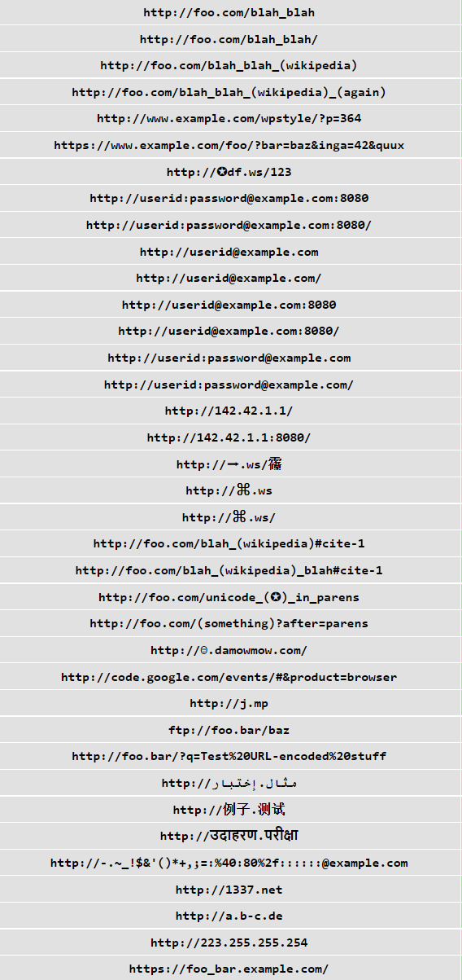
Data cleaning of commit message
1.url(556)
2.Merge branch XXX into XXX(303)
3.Merge branch XXX of XXX into XXX(154)
4.Merge branch XXX(167)
5.Merge remote-tracking branch XXX (61)
5.Merge remote-tracking branch XXX into XXX(105)
6.File and path(1842+6077)
Some were mis-deleted, as they look like a path
(atches/sleeps, discussed/aligned, begin/end)
7.Function(1154)
8.Code (961)
`insert(RealmModel obj)`, `insertOrUpdate(RealmModel obj)`, `insert(Collection<RealmModel> collection)` and `insertOrUpdate(Collection<RealmModel> collection)`

Slide 6
Data of commit message
project_name | single_line | multi_line | total
Anki-Android | 4474 | 68 | 4542
bnd | 0 | 0 | 0
checkstyle | 5456 | 257 | 5713
che | 1112 | 369 | 1481
cleanflight | 0 | 0 | 0
druid | 13188 | 85 | 13273
elasticsearch | 1329 | 0 | 1329
framework | 21201 | 9789 | 30990
gatk | 19466 | 300 | 19766
graylog2-server | 1979 | 23 | 2002
grpc-java | 4019 | 6155 | 10174
jabref | 3010 | 134 | 3144
k-9 | 1946 | 906 | 2852
k | 9493 | 1566 | 11059
mage | 6395 | 80 | 6475
MinecraftForge | 461 | 18 | 479
molgenis | 6620 | 59 | 6679
muikku | 3303 | 13 | 3316
nd4j | 32948 | 19869 | 52817
neo4j | 82500 | 1848 | 84348
netty | 23172 | 760 | 23932
OsmAnd | 1150 | 176 | 1326
presto | 0 | 0 | 0
realm-java | 19509 | 1026 | 20535
reddeer | 4 | 0 | 4
RxJava | 3050 | 3293 | 6343
smarthome | 1261 | 16 | 1277
Terasology | 3485 | 9077 | 12562
wildfly-camel | 0 | 0 | 0
XChange | 4224 | 618 | 4842
xp | 29 | 0 | 29
zaproxy | 0 | 0 | 0
pinpoint | 38910 | 13366 | 52276
 |  |  | 383,565

Slide 7
Data of pull request
project_name | title | body | commit | review_comments | issue_comments | reviews | commit_comment | total
Anki-Android | 154 | 146 | 776 | 79 | 747 | 0 | 28 | 1930
bnd | 1 | 1 | 247 | 0 | 0 | 0 | 0 | 249
che | 4 | 4 | 11 | 40 | 33 | 39 | 0 | 131
checkstyle | 68 | 59 | 179 | 299 | 603 | 265 | 0 | 1473
cleanflight | 0 | 0 | 0 | 0 | 0 | 0 | 0 | 0
druid | 1102 | 955 | 8490 | 20035 | 5797 | 8343 | 155 | 44877
elasticsearch | 67 | 62 | 4235 | 366 | 204 | 2 | 50 | 4986
framework | 75 | 75 | 601 | 0 | 457 | 0 | 0 | 1208
gatk | 403 | 377 | 2325 | 12537 | 2512 | 3918 | 19 | 22091
graylog2-server | 186 | 182 | 4252 | 696 | 266 | 307 | 21 | 5910
grpc-java | 81 | 68 | 124 | 681 | 245 | 3 | 1 | 1203
jabref | 34 | 31 | 972 | 127 | 250 | 7 | 39 | 1460
k | 37 | 24 | 531 | 84 | 62 | 109 | 13 | 860
k-9 | 272 | 254 | 1982 | 615 | 573 | 254 | 50 | 4000
mage | 36 | 23 | 246 | 1 | 43 | 0 | 25 | 374
MinecraftForge | 67 | 62 | 2483 | 242 | 312 | 133 | 361 | 3660
molgenis | 562 | 216 | 12904 | 682 | 130 | 0 | 10 | 14504
muikku | 510 | 387 | 13239 | 3647 | 36 | 1721 | 56 | 19596
nd4j | 727 | 575 | 5825 | 327 | 1954 | 199 | 28 | 9635
neo4j | 1770 | 1237 | 19071 | 8688 | 2591 | 3162 | 51 | 36570
netty | 134 | 108 | 7524 | 707 | 582 | 494 | 476 | 10025
OsmAnd | 6 | 0 | 261 | 0 | 1 | 1 | 2 | 271
pinpoint | 227 | 134 | 618 | 25 | 74 | 4 | 0 | 1082
presto | 0 | 0 | 0 | 0 | 0 | 0 | 0 | 0
realm-java | 723 | 604 | 8263 | 6545 | 2473 | 1605 | 101 | 20314
reddeer | 3 | 2 | 3 | 0 | 4 | 0 | 0 | 12
RxJava | 242 | 222 | 1174 | 203 | 1088 | 0 | 42 | 2971
smarthome | 192 | 182 | 797 | 3052 | 1414 | 1201 | 7 | 6845
Terasology | 64 | 57 | 921 | 85 | 421 | 0 | 0 | 1548
wildfly-camel | 64 | 3 | 167 | 3 | 67 | 5 | 3 | 312
XChange | 336 | 246 | 2796 | 364 | 675 | 227 | 43 | 4687
xp | 1 | 0 | 3 | 0 | 0 | 0 | 0 | 4
zaproxy | 0 | 0 | 0 | 0 | 0 | 0 | 0 | 0
 |  |  |  |  |  |  |  | 222,788

Slide 8
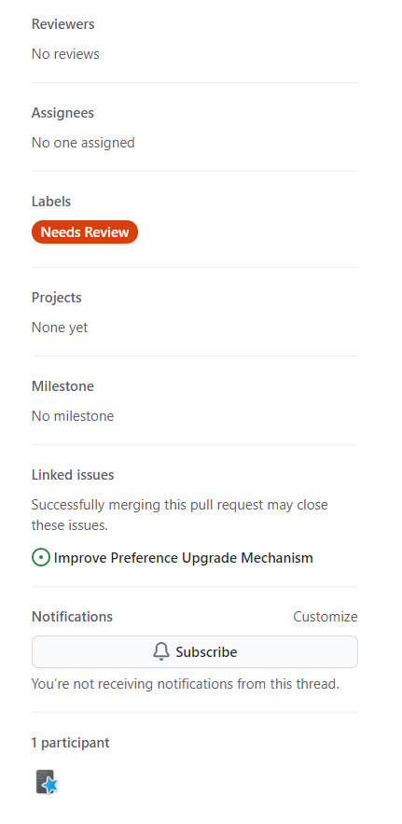
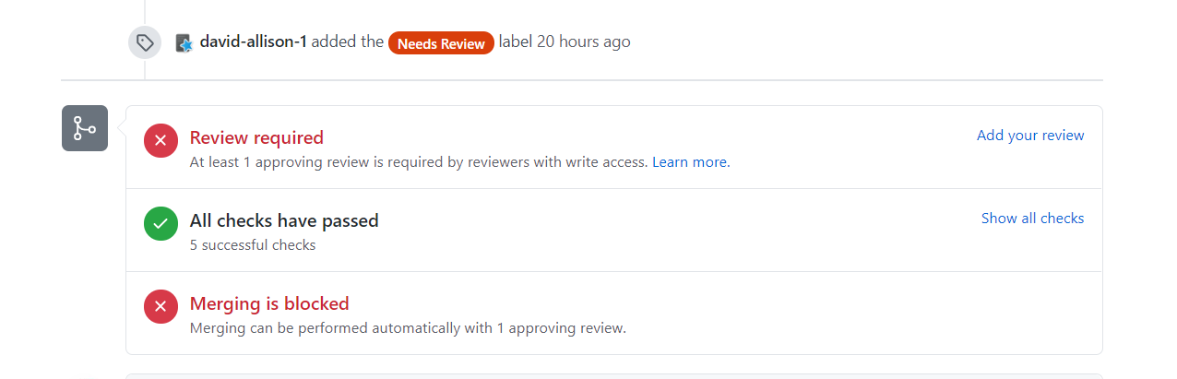
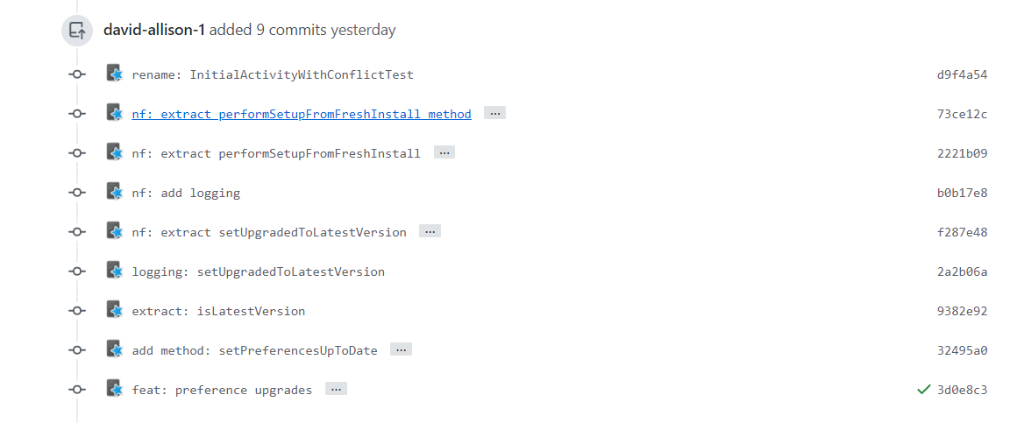
Data dropped

Slide 9
Data cleaning of pull request
1.url(30028)
2. Code (4084+55880)
Example:
`reduce(seed, accumulator).map(resultSelector)`
```\ngroupBy().take(1).mapMany(group -> group.take(20))\n```
3. SHA(9361)
4. <XXX>(84521)
5.Function(10754)
6.File and path(6937+52938)

Slide 10
Next Step
1.Find out way to collect code, system log, error message etc.
2.Conduct data pre-processing

